Slide 1
Approach of
Unit testing with the help of JUnit
Satish Mishra
mishra@informatik.hu-berlin.de

Slide 2
About me
Satish Mishra
Master of Electronics Science from India
Worked as Software Engineer,Project Manager,Quality Assurance Lead in Software development firm
Presently Doing PhD in Computer Science

Slide 3
This session
Testing concepts
  Unit testing
Testing tools
  JUnit
Practical use of tools
  Examples
Discussions
  Open to you all

Slide 4
Why?
Why testing?
  Improve software design
  Make software easier to understand
  Reduce debugging time
  Catch integration errors
In short, to Produce Better Code
Preconditions
  Working code
  Good set of unit tests

Slide 5
What should be tested ?
Test for boundary conditions
Test for both success and failure
Test for general functionality
Etc..

Slide 6
When to start testing
Software quality and testing is a
life-cycle process

Slide 7
When to start testing...
At the time of starting the projects
How we start the projects ??
Do we have any formal way ??

Slide 8
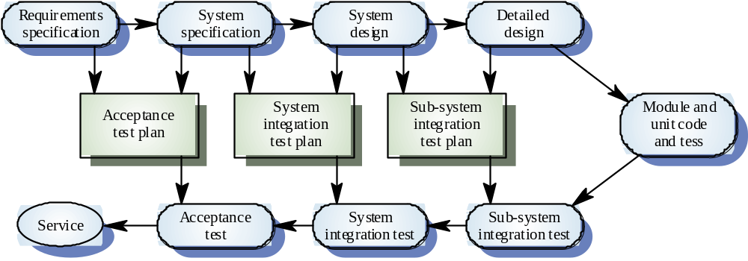
The V-model of development

Slide 9
Fact of testing
Testing does not guarantee
the absence of defects

Slide 10
What is test case
A test case is a document that describes an input, action, or event and an expected response, to determine if a feature of an application is working correctly

Slide 11
Good test case design
An good test case satisfies the following criteria:
  Reasonable probability of catching an error
  Does interesting things
  Doesn’t do unnecessary things
  Neither too simple nor too complex
  Not redundant with other tests
  Makes failures obvious
  Mutually Exclusive, Collectively Exhaustive

Slide 12
Test case design technique
Test case design techniques can be broadly split into two main categories
  Black box (functional)
  White box (structural)

Slide 13
Black Box tests
Input
Output
Targeted at the apparent simplicity of the software
  Makes assumptions about implementation
  Good for testing component interactions
Tests the interfaces and behavior
Notes:
Black box: “Tester’s tests” – make assumptions about how things work, and then create tests to try to exploit weaknesses or holes in the software.
In general, useful for testing interaction (or aggregate behavior). Also useful for testing UI elements or other event-driven or non-deterministic scenarios.
Exercising “unusual” situations (out of memory, our of disk space, network failure, power failure, etc.) typically falls under black box testing.
Apparent simplicity: Black box testing tries to ignore the implementation and interact with the software the same way a user might. Ignoring implementation details often leads the tester to find “edge cases” that the developer did not anticipate, or usage scenarios that are unsupported (or partially supported) and don’t work at all (or only work partially). This also exploits the fact that most software is designed to make things easy by “hiding” the complexity of the software from the user – but just because the complexity is hidden doesn’t mean it goes away. Often times the steps taken to hide complexity from the user introduce completely new bugs!
Interfaces: tests the “surface” of the component and its interactions with other pieces of software
Behavior: tests how the software reacts do inputs (i.e., “poke it like <this> and see what happens”)

Slide 14
White Box tests
Input
Output
Targeted at the underlying complexity of the software
  Intimate knowledge of implementation
  Good for testing individual functions
Tests the implementation and design
Notes:
White box: “Developer’s tests” – typically confirm known-good behavior, or target implementation-specific weaknesses.
In general, good for function-level tests.
Too much knowledge can sometimes be a bad thing. If the code “looks good”, there is a temptation to avoid tests because they “look like they should pass”.
Underlying complexity: The software may try to appear simple to the user, but the underlying implementation details are often extremely complex. By testing with knowledge of the implementation, testers can create tests that are designed to exacerbate the internal details of the software that the user is normally hidden from. This includes interactions with other software components, etc. These bugs often occur because the capabilities of the underlying software are often much larger than the features exposed directly to the user. Since the user doesn’t (normally) exercise many of these capabilities, they often contain many bugs!
Grady Booch: “It is our job … ultimately to build the illusion of simplicity.” This illusion is extremely complex! (Layer on layer, abstraction on abstraction)
Actual simplicity is (often) not very useful!
Implementation: tests are directed at specific weaknesses in the design (e.g., target the worst-case scenario for sorts, the slowest times for search, the most memory-intensive for copies, etc.)
Design: tests use inputs chosen to show the code works for “almost all possible” ranges of input (specifically targets “edge cases”, etc.)

Slide 15
Test case writing example
Suppose we have two parameters we want to cover in a set of tests. Parameters are as follows..
Operating system
  Win98
  Win2k
  Winxp
Printers
  HP 4100
  HP 4200
How We should write test case for this ??

Slide 16
Types of Tests
Unit
  Individual classes or types
Component
  Group of related classes or types
Integration
  Interaction between classes
Notes:
These “types” are certainly not exhaustive, but it is useful to know how tests are often broken down conceptually.
Unit: Smallest useful piece of software, and often has the smallest tests. Often (but not always), these are “sanity checks” to make sure code changes haven’t broken anything obvious.
Component: Test the behavior of a class (or groups of related classes) on a whole. Should cover all methods / properties / etc., and should cover as many “valid” inputs as possible.
Integration: Test behavior of components interacting with each other. These tests should cover more “unusual” scenarios, such as invalid inputs. This is a good place to test for classes being “time sensitive” – that is, whether method calls work independent of when they occur.
Integration testing may also include UI testing, end-to-end scenarios, etc.

Slide 17
What is a testing framework?
A test framework provides reusable test functionality which:
  Is easier to use (e.g. don’t have to write the same code for each class)
  Is standardized and reusable
  Provides a base for regression tests

Slide 18
Why use a testing framework?
Each class must be tested when it is developed
Each class needs a regression test
Regression tests need to have standard interfaces
Thus, we can build the regression test when building the class and have a better, more stable product for less work

Slide 19
Regression testing
New code and changes to old code can affect the rest of the code base
  ‘Affect’ sometimes means ‘break’
We need to run tests on the old code, to verify it works – these are regression tests
Regression testing is required for a stable, maintainable code base

Slide 20
Testing tools
Tools are part of the quality
equation, but not the entire
equation

Slide 21
JUnit
JUnit is a framework for writing unit tests
  A unit test is a test of a single class
    A test case is a single test of a single method
    A test suite is a collection of test cases
Unit testing is particularly important when software requirements change frequently
  Code often has to be refactored to incorporate the changes
  Unit testing helps ensure that the refactored code continues to work

Slide 22
JUnit..
JUnit helps the programmer:
  Define and execute tests and test suites
  Formalize requirements and clarify architecture
  Write and debug code
  Integrate code and always be ready to release a working version

Slide 23
What JUnit does
JUnit runs a suite of tests and reports results
For each test in the test suite:
  JUnit calls setUp()
    This method should create any objects you may need for testing

Slide 24
What JUnit does…
  JUnit calls one test method
    The test method may comprise multiple test cases; that is, it may make multiple calls to the method you are testing
    In fact, since it’s your code, the test method can do anything you want
    The setUp() method ensures you entered the test method with a virgin set of objects; what you do with them is up to you
  JUnit calls tearDown()
    This method should remove any objects you created

Slide 25
Creating a test class in JUnit
Define a subclass of TestCase
Override the setUp() method to initialize object(s) under test.
Override the tearDown() method to release object(s) under test.
Define one or more public testXXX() methods that exercise the object(s) under test and assert expected results.
Define a static suite() factory method that creates a TestSuite containing all the testXXX() methods of the TestCase.
Optionally define a main() method that runs the TestCase in batch mode.

Slide 26
Fixtures
A fixture is just a some code you want run before every test
You get a fixture by overriding the method
  protected void setUp() { …}
The general rule for running a test is:
  protected void runTest() {
  setUp(); <run the test> tearDown();
  }
  so we can override setUp and/or tearDown, and that code will be run prior to or after every test case

Slide 27
Implementing setUp() method
Override setUp() to initialize the variables, and objects
Since setUp() is your code, you can modify it any way you like (such as creating new objects in it)
Reduces the duplication of code

Slide 28
Implementing the tearDown() method
In most cases, the tearDown() method doesn’t need to do anything
  The next time you run setUp(), your objects will be replaced, and the old objects will be available for garbage collection
  Like the finally clause in a try-catch-finally statement, tearDown() is where you would release system resources (such as streams)

Slide 29
The structure of a test method
A test method doesn’t return a result
If the tests run correctly, a test method does nothing
If a test fails, it throws an AssertionFailedError
The JUnit framework catches the error and deals with it; you don’t have to do anything

Slide 30
Test suites
In practice, you want to run a group of related tests (e.g. all the tests for a class)
To do so, group your test methods in a class which extends TestCase
Running suites we will see in examples

Slide 31
assertX methods
static void assertTrue(boolean test)
static void assertFalse(boolean test)
assertEquals(expected, actual)
assertSame(Object expected, Object actual)
assertNotSame(Object expected, Object actual)
assertNull(Object object)

Slide 32
assertX methods
assertNotNull(Object object)
fail()
All the above may take an optional String message as the first argument, for example,
static void assertTrue(String message, boolean test)

Slide 33
Organize The Tests
Create test cases in the same package as the code under test
For each Java package in your application, define a TestSuite class that contains all the tests for validating the code in the package
Define similar TestSuite classes that create higher-level and lower-level test suites in the other packages (and sub-packages) of the application
Make sure your build process includes the compilation of all tests

Slide 34
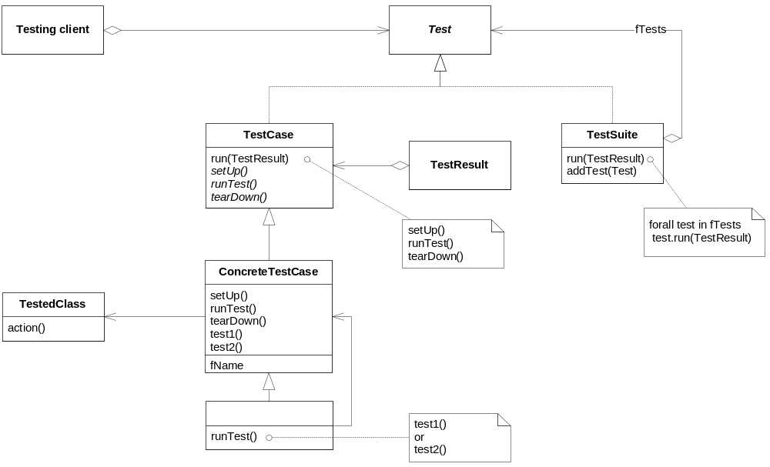
JUnit framework

Slide 35
Example: Counter class
For the sake of example, we will create and test a trivial “counter” class
  The constructor will create a counter and set it to zero
  The increment method will add one to the counter and return the new value
  The decrement method will subtract one from the counter and return the new value

Slide 36
Example: Counter class
We write the test methods before we write the code
  This has the advantages described earlier
  Depending on the JUnit tool we use, we may have to create the class first, and we may have to populate it with stubs (methods with empty bodies)
Don’t be alarmed if, in this simple example, the JUnit tests are more code than the class itself

Slide 37
JUnit tests for Counter
public class CounterTest extends junit.framework.TestCase {
Counter counter1;
public CounterTest() { } // default constructor
protected void setUp() { // creates a (simple) test fixture
counter1 = new Counter();
}
protected void tearDown() { } // no resources to release

Slide 38
JUnit tests for Counter…
public void testIncrement() {
assertTrue(counter1.increment() == 1);
assertTrue(counter1.increment() == 2);
}
public void testDecrement() {
assertTrue(counter1.decrement() == -1);
}
} // End from last slide

Slide 39
The Counter class itself
public class Counter {
int count = 0;
public int increment() {
return ++count;
}
public int decrement() {
return --count;
}
public int getCount() {
return count;
}
}

Slide 40
Result
We will see with the help of tool
When ??
!! Now !!

Slide 41
Why JUnit
Allow you to write code faster while increasing quality
Elegantly simple
Check their own results and provide immediate feedback
Tests is inexpensive
Increase the stability of software
Developer tests
Written in Java
Free
Gives proper uniderstanding of unit testing

Slide 42
Problems with unit testing
JUnit is designed to call methods and compare the results they return against expected results
  This ignores:
    Programs that do work in response to GUI commands
    Methods that are used primary to produce output

Slide 43
Problems with unit testing…
I think heavy use of JUnit encourages a “functional” style, where most methods are called to compute a value, rather than to have side effects
  This can actually be a good thing
  Methods that just return results, without side effects (such as printing), are simpler, more general, and easier to reuse

Slide 44
The End
Thank You

